Slide 1



PROJECT MANAGEMENT IN PRACTICE
Communications Revisited
Lecture No: 18 Week: 10
Vispi Shroff
Sub Heading
And Date

Slide 2

Recap
We looked at Earned Value Management
Planned Value, Earned Value, Actual Cost
Schedule Variance, Cost Variance
Schedule Variance Index
Cost Variance Index
How to use EVM to measurement, analysis and forecasting.

Slide 3
Communications Cycle
Idea Generation
Encoding
Transmitting
Channels
Receiving
Decoding
Understanding
Response
Know what your purpose is
Choose an appropriate context and medium
Send clear signals
Actively ensure that others understand the message
Noise, Barriers, Filters

Slide 4
Methods of Communication - Activity
- Types of Communication – Ex. Face-to-face
Modes of communication
Advantages
Disadvantages

Slide 5
Barriers to Communication
Individual Barriers
Difference in Status
The credibility of the Source
Perceptual Biases
Organisational Barriers
Information Overload
Time Pressures
Organizational Cultures
Technology

Slide 6
It isn’t only about talking..
Listening
Demonstrate non-verbally that you are listening
Actively Interpret the Sender’s Message
Interpret the sender’s nonverbal behaviour
Avoid becoming defensive

Slide 7
Methods of Communication - Activity
- Types of Communication – Ex. Face-to-face
Modes of communication
Advantages
Disadvantages

Slide 8
Conflict Handling Modes
Confrontation: directly face a conflict using a problem-solving approach
Compromise: use a give-and-take approach
Smoothing: de-emphasize areas of difference and emphasize areas of agreement
Forcing: the win-lose approach
Withdrawal: retreat or withdraw from an actual or potential disagreement
Collaborating: decision makers incorporate different viewpoints and insights to develop consensus and commitment

Slide 9
Conflict can be good
Conflict often produces important results, such as new ideas, better alternatives, and motivation to work harder and more collaboratively
Groupthink: conformance to the values or ethical standards of a group; groupthink can develop if there are no conflicting viewpoints
Research suggests that task-related conflict often improves team performance, but emotional conflict often depresses team performance

Slide 10
Developing Better Communication Skills
- Companies and formal degree programs for IT professionals often neglect the importance of speaking, writing, and listening skills
- As organizations become more global, they realize they must invest in ways to improve communication with people from different countries and cultures
- It takes leadership to improve communication

Slide 11
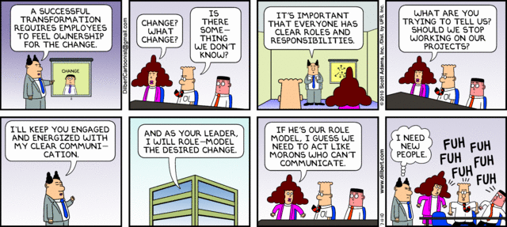
Any Thoughts, Questions, Ideas?

Slide 12
Reading Materials for the Week
Schwalbe, K., 2007. Information Technology Project Management 5th ed., United States of America: Thomson Course Technology. Chapter 10
PMBOK Guide – Chapter 10

Slide 13
References
Schwalbe, K., 2007. Information Technology Project Management 5th ed., United States of America: Thomson Course Technology. Chapter 10
PMBOK Guide – Chapter 10
Hughes, R.L., Ginnett, R.C. & Curphy, G.J., 2009. Leadership: Enhancing the Lessons of Experience Sixth., Singapore: McGraw Hill.
Vecchio, R.P., 2006. Organizational Behavior - Core Concepts 6th ed., Thompson South-Western.
Dilbert Comics

